Slide 1

Customer Shopping Behavior Analysis
Uncovering insights from 3,900 purchases to guide strategic business decisions through data-driven analysis of spending patterns, customer segments, and product preferences.

Slide 2

Dataset Overview
3,900
18
37
Total Purchases
Data Features
Missing Values
Transactions analyzed across all categories
Comprehensive customer and purchase attributes
Found only in Review Rating column

Slide 3

Key Data Features
Customer Demographics
Shopping Behavior
Discount Applied
Age and Gender
Previous Purchases
Location
Frequency of Purchases
Subscription Status
Review Rating
Purchase Details
Shipping Type
Item and Category
Purchase Amount
Season, Size, Color

Slide 4
Data Preparation Process
01
02
Data Loading
Handle Missing Data
Imported CSV into PostgreSQL database
Imputed missing review ratings using median by category
03
04
Column Standardization
Feature Engineering
Renamed columns to snake case for consistency
Created age_group and purchase_frequency_days columns
05
06
Data Consistency
Power BI Integration
Verified redundancy and dropped promo_code_used
Connected database for dashboard creation

Slide 5
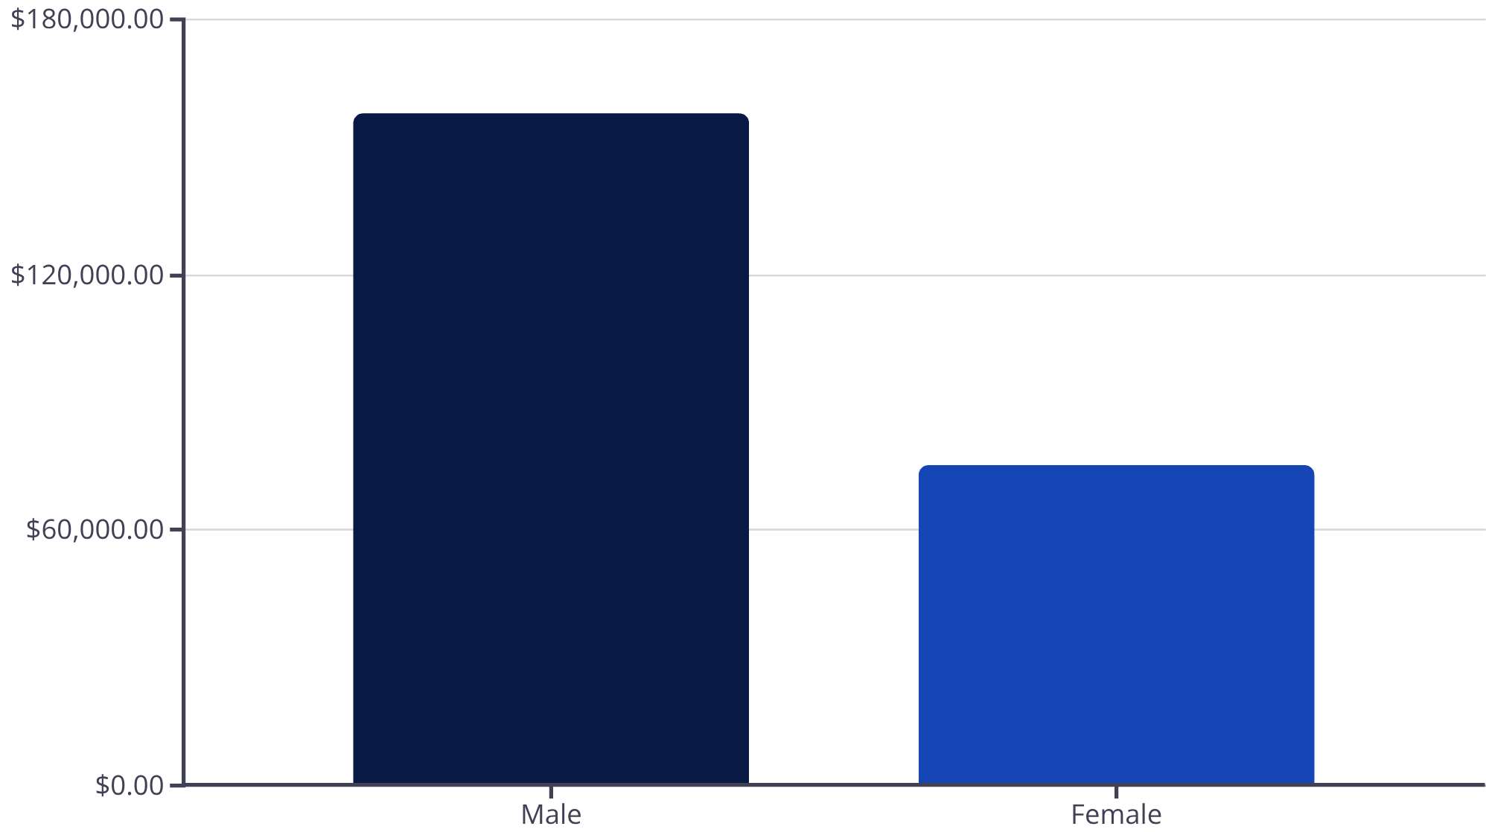
Revenue Analysis by Gender
Male customers generated $157,890 in total revenue, more than double the $75,191 from female customers.
This significant gap suggests opportunities for targeted marketing to increase female customer engagement.

Slide 6

Key Insights from Analysis
High-Spending Discount Users
Top-Rated Products
Gloves (3.86), Sandals (3.84), and Boots (3.82) received highest average review ratings from customers.
17 customers used discounts but still spent above average purchase amount, showing price-conscious yet valuable buyers.
Shipping Preferences
Express shipping users spent $60.48 on average vs. $58.46 for Standard, indicating willingness to pay more.

Slide 7


Subscription Status Comparison
$59.49
$59.87
Subscribers
Non-Subscribers
Average spend per purchase
Average spend per purchase
Total Revenue
Despite similar average spend, non-subscribers generate significantly more total revenue, suggesting a larger customer base without subscriptions.
Subscribers: $62,645
Non-Subscribers: $170,436

Slide 8
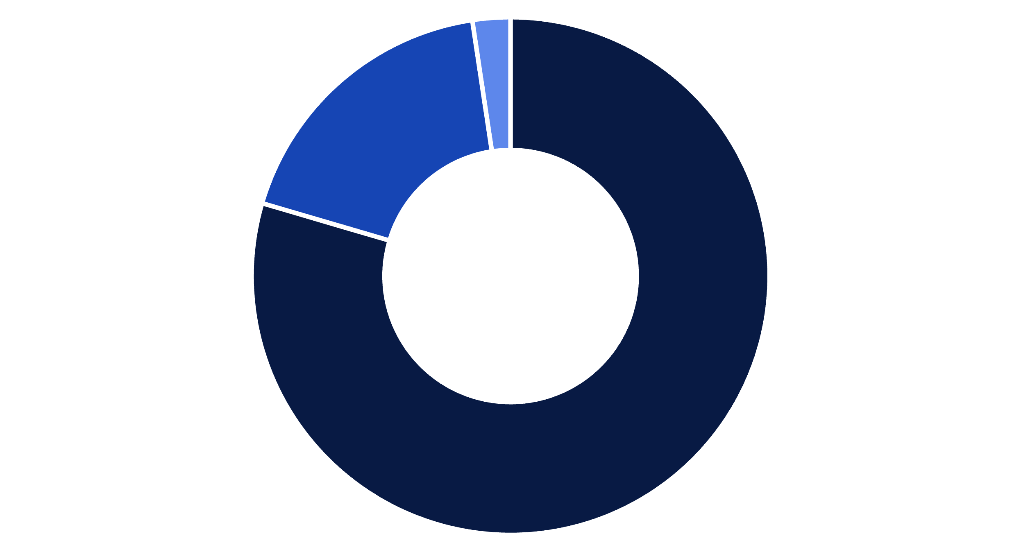
Customer Segmentation
Loyal
Returning
New
Loyal Customers
Returning Buyers
New Customers
80% of customer base with multiple purchases
18% showing repeat purchase behavior
2% representing growth opportunity

Slide 9

Product Performance Insights
Discount-Dependent Products
Top Products by Category
Accessories: Jewelry (171 orders)
Hat – 50% discount rate
Clothing: Blouse & Pants (171 orders each)
Sneakers – 49.66%
Coat – 49.07%
Footwear: Sandals (160 orders)
Sweater – 48.17%
Pants – 47.37%
Outerwear: Jacket (163 orders)
958 repeat buyers (>5 purchases) have subscriptions, while 2,518 don't, indicating untapped subscription potential among loyal customers.

Slide 10





Strategic Recommendations
Boost Subscriptions
Promote exclusive benefits to convert loyal non-subscribers into subscription members.
Customer Loyalty Programs
Reward repeat buyers to accelerate their journey into the "Loyal" segment.
Review Discount Policy
Balance promotional sales boosts with margin control for sustainable profitability.
Targeted Marketing
Focus campaigns on high-revenue age groups, top-rated products, and express-shipping users.

